Slide 1

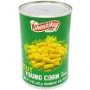
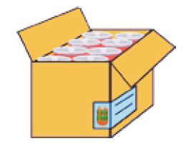
Simple Pack
Step 1
Create
Regular Item
Step 2
Create
Simple Pack (TPND)
Each
Case
Level 1
Canned Corn
- UCC 12
Store SOH is
held at the
each/TPNB
level
Level 2
12 Oz.
Canned Corn
- ORIN
Level 1 - Case
- ORIN
Orderable
WH SOH is
Held at the
simple pack/TPND
Level 3
EAN/UCC
Level 2 - Case
- OCC (EAN 14)

Slide 2
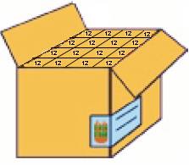
ITEM - LEVEL DEFINITION - Inners
Simple Pack (Inner) of 12 Eaches
Item Qty = 12
Case Qty = 16 (Inners per Case)
Unit Cost = $6 (Item unit cost * Pack Item Qty)
Case Cost = $96 (Pack Unit Cost * Pack Case Qty)
Step 1
Create
Regular Item
Each
Parent Item/Style
Item Level = I
Transaction Level = 2
UCC 12
Case with Inners
Step 2
Create
Simple Pack (Inner)
Store SOH is
held at the
each
SKU/Transaction Level Item
Simple Pack (Inner)
Item Level = 2
Transaction Level = 2
ORIN
Item Level = 1
Transaction Level = 1
ORIN
Case of 192 Eaches
Inner Qty = 12
Case Qty = 192
Unit Cost = $0.5
Case Cost = $96
No Level 2 for Simple Pack
WH SOH is
Held at the
simple pack
Item Level = 3
Transaction Level = 2
EAN 8/13 / UCC12
Item Barcode

